Slide 1
Chronic Kidney Disease Prediction
CMPE 239 Project
TEAM members:
Mahitha byreddy (010732787)
Shreya prabhu (010374507)
Charmili narra (010641891)

Slide 2
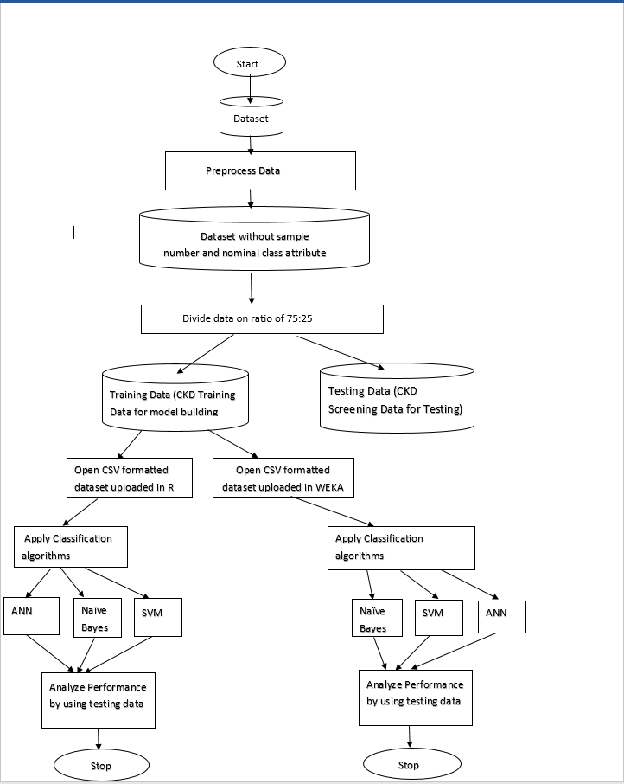
architecture

Slide 3
Data sets
Source of Dataset: National Center for Health Statistics of the Centers for Disease Control and Prevention
Size of the Dataset : 10219 Records
Relevant Data: 8219 Records
Training Data: 6000 Records
Test Data: 2219 Records

Slide 4
Application flow
Obtain the data
Preprocess the data
Divide data into training and test data
Train Naïve Bayes, SVM and ANN Classifier using modeled data
Compare Recognition results for all classifiers
Obtain input from the user for data visualization
Generate prediction results
Insert new input rom user into the testing data set and modify the classifier model

Slide 5
Data mining principles and algorithms used
Naïve Bayes
Support Vector Machine
Artificial Neural Network

Slide 6
Naïve Bayes
It is a simple probabilistic classifier which calculates a set of probabilities by counting the frequency and combinations of values in a given dataset.
Bayes theorem:
P (Z|W) = P (W|Z) ·P(Z) / P(W).
P(W) is constant for all classes.
P(Z) = relative freq of class Z samples z such that p is increased=z Such that P (W|Z).P(Z) will increase
Problem: computing P (W|Z) is unfeasible!

Slide 7
Support vector machine
This algorithm performs the classification by constructing a multi-dimensional hyper plane that separates two classes. This algorithm accomplishes high discriminative power by utilizing unique non linear capacities of functions called kernels to change the input space into a multi-dimensional space.

Slide 8
Artificial Neural network
Relatively crude electronic models based on neural structure of the brain.
Simulate the four basic functions of natural neurons-input, processing, transfer and output
Operates in three layers-input layer, hidden layer and the output layer

Slide 9
KDD principles
Data Cleansing:
Removed unwanted columns and unrelated columns and finally created the data set which has to be trained.
Data Integration:
One data source i.e. National Center for Health Statistics of the Centers for Disease Control and Prevention
Data selection:
Selected the data that is required for predicting the likelihood of getting CKD. Hence we have created the database for using fields. This is our target dataset. We have a CSV file from the CSV file we have extracted useful columns. Thus we have created the data set and prepared it for preprocessing.

Slide 10
Kdd principles
Data Transformation:
Program in Weka and R studio generates data with following columns: weight ,height, age, gender, Diabetes, SBP,DBP etcetera
Classification:
Used Naive Bayes Classifier, SVM and ANN classifier to predict the likelihood of getting chronic kidney disease given the symptoms.
Knowledge presentation:
Prediction of likelihood of getting chronic kidney disease given the symptoms and giving comparison of prediction accuracies of different classifiers.

Slide 11
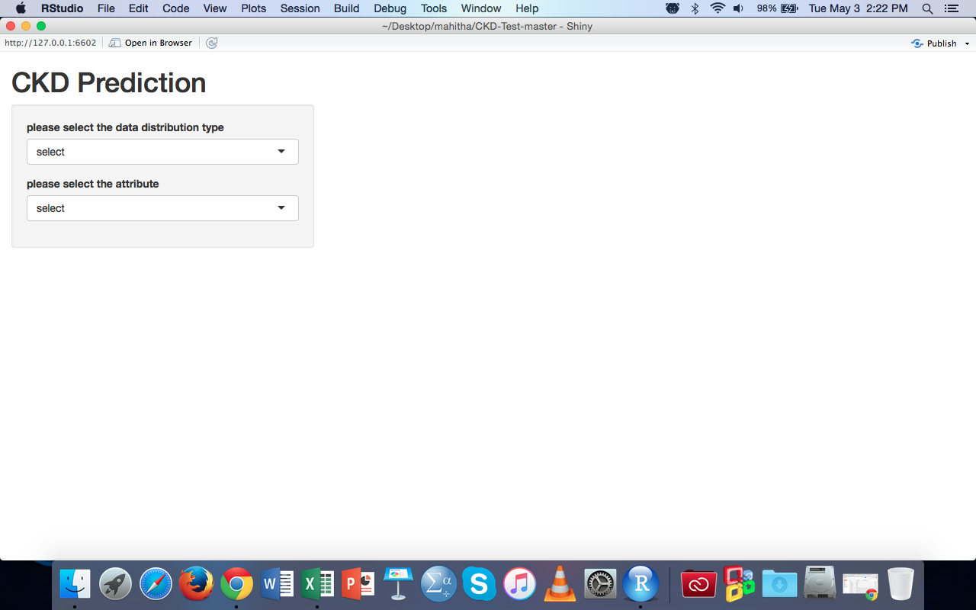
UI design and application

Slide 12
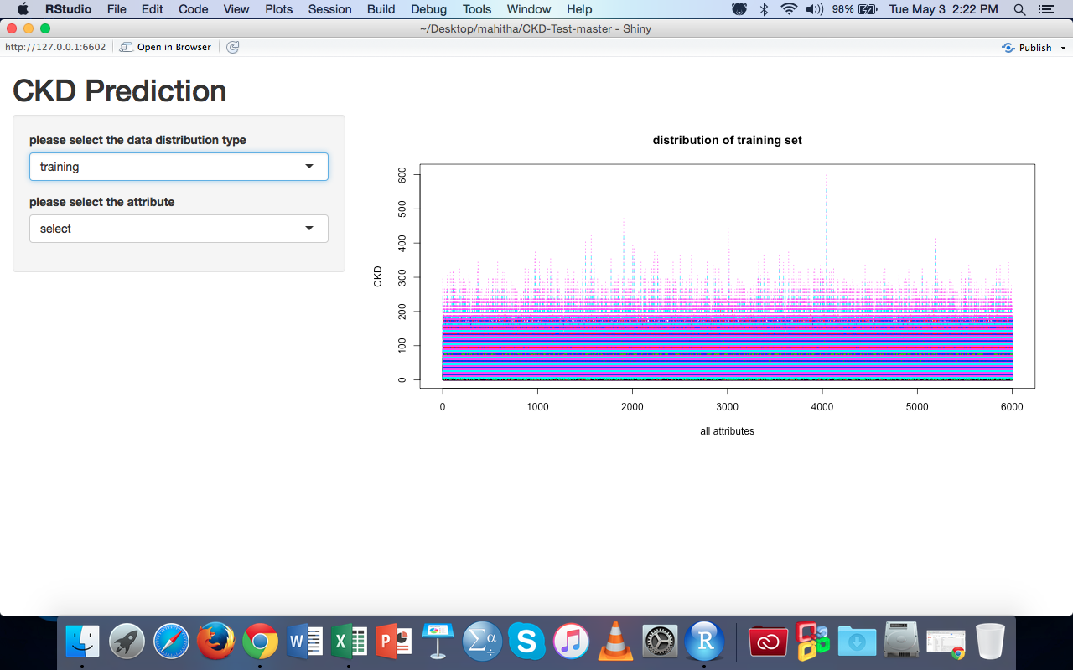
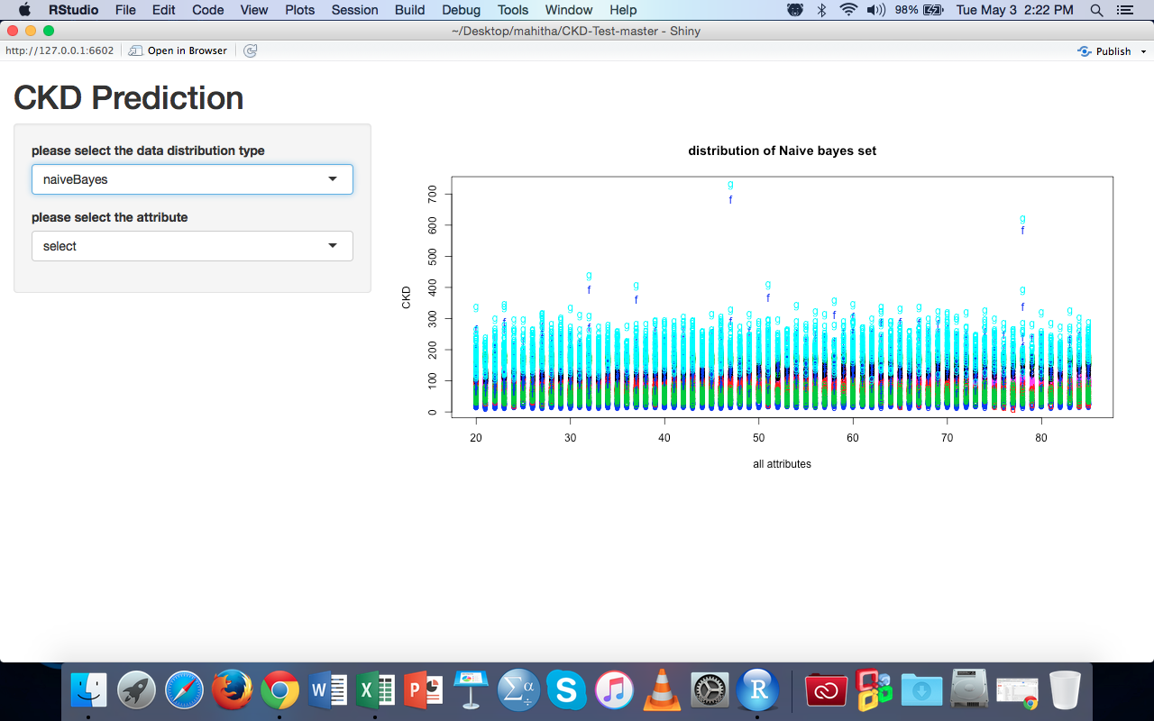
UI design and application

Slide 13
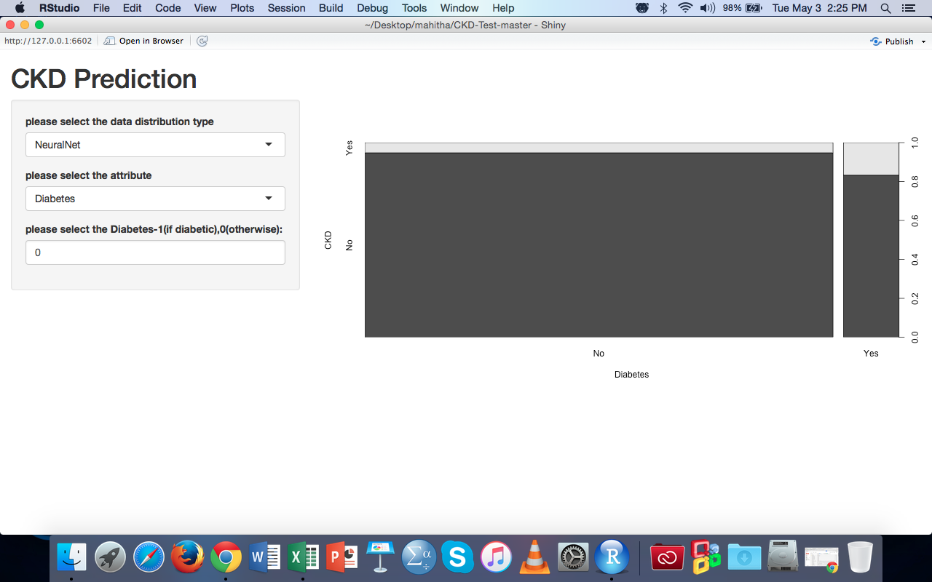
UI design and application

Slide 14
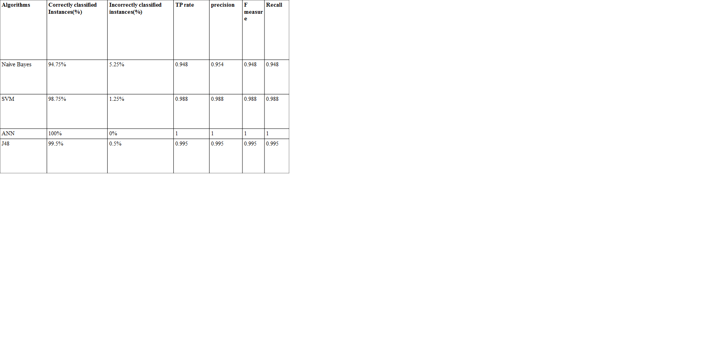
Results and conclusion

Slide 15
Future work
Established that Artificial Neural Networks works the best when performance accuracy is taken into consideration.
When execution time is taken into consideration, Naïve Bayes worked the best.
So in future, ANN algorithm is to be improved to minimize the execution time.

Slide 16
Thank you

